Slide 1
Android build environment
Based on CSR android-2.3.7
Yuanzhe Liu
Sep, 2012

Slide 2
Agenda
Setup build environment
Get source code
Build code
Flash image to development Board

Slide 3
Setup build environment
Host should be 64bit Ubuntu10.04, or newer version.
For Ubuntu10.04, please refer to following conmmand to install essential software.
Required packaged
$ sudo apt-get install git-core gnupg sun-java6-jdk flex bison gperf libsdl-dev
libesd0-dev libwxgtk2.8-dev
$ sudo apt-get install build-essential zip curl libncurses5-dev zlib1g-dev tofrodos
libglib2.0-dev
$ sudo apt-get install vim minicom ckermit meld ccache indent ssh subversion
$ sudo apt-get install libgmp3c2 libgmpxx4ldbl libgmp3-dev libmpc2 libmpc-dev
libmpfr-dev libmpfr1ldbl
$ sudo ln -s /usr/lib/libmpfr.so.1 /usr/lib/libmpfr.so.4
Install JDK1.6 64bit
$ sudo add-apt-repository "deb http://archive.canonical.com/lucid partner"
$ sudo apt-get update
$ sudo apt-get install sun-java6-jdk

Slide 4
Setup build environment
If you can’t get jdk from Unbutu software source. You can also get JDK1.6 from Web.
http://www.oracle.com/technetwork/java/javase/downloads/index.html
2. If your host is a newer Ubuntu or other OS, please refer
http://source.android.com/source/initializing.html

Slide 5
Get source code
Get android source code form p4
IP: 10.80.98.24:3530
Path: //RSP/os/linux/oss/android/
The document is based on android-2.3.7-csr_MR2.tar.bz2

Slide 6
Build code
Build code
Uncompress android-2.3.7-csr_MR2.tar.bz2
$mkdir ~/workspace
$cd ~/workspace
$ tar jxvf android-2.3.7-csr_MR2.tar.bz2 -C ~/workspace
2. To build the whole source tree:
1). Enter the project root directory.
$make
2). Enter the Android directory and build the code.
$cd android
$ make –j8
3). In the project root directory, copy the images to out/prima2cb.
$cd ..
$make android

Slide 7
Build code
Build error shooting
If occur error like “Could not load 'clearsilver-jni'java”, please check your java version. Must be JDK1.6 64-bit.
$ java -version
java version "1.6.0_33"
Java(TM) SE Runtime Environment (build 1.6.0_33-b03)
Java HotSpot(TM) 64-Bit Server VM (build 20.8-b03, mixed mode)

Slide 8
Flash image to development Board
You should insert SD card(More than 2G) which should connect with SD card reader to your PC.
Find your SD device in ubuntu.
$mount
….
/dev/sda1 on / type ext4 (rw,errors=remount-ro)
…..
/dev/sdb on /media/5433-DD54 type vfat
…...
Flash image to SD card
$ cd out/prima2cb
$ sudo ./flash.sh sdb all
(Attention: SD device maybe sda or sdc in your PC.)
My SD card

Slide 9
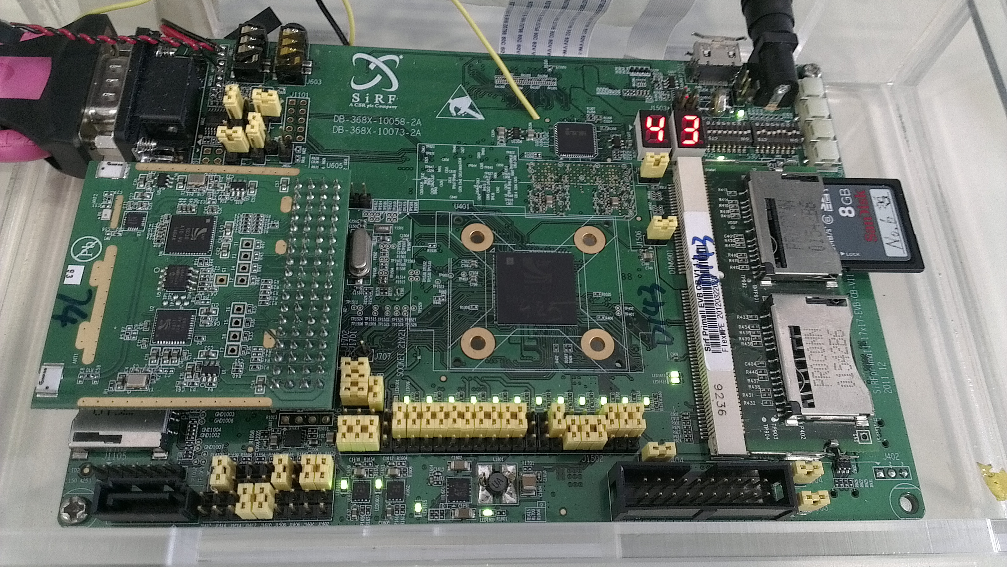
Bring up board
Android(for CSR) is boot from SD card, not Nand flash.
Insert SD card to first SD slot(close to digital tube)
Press reset key. Done!
first SD slot
reset key

Slide 10
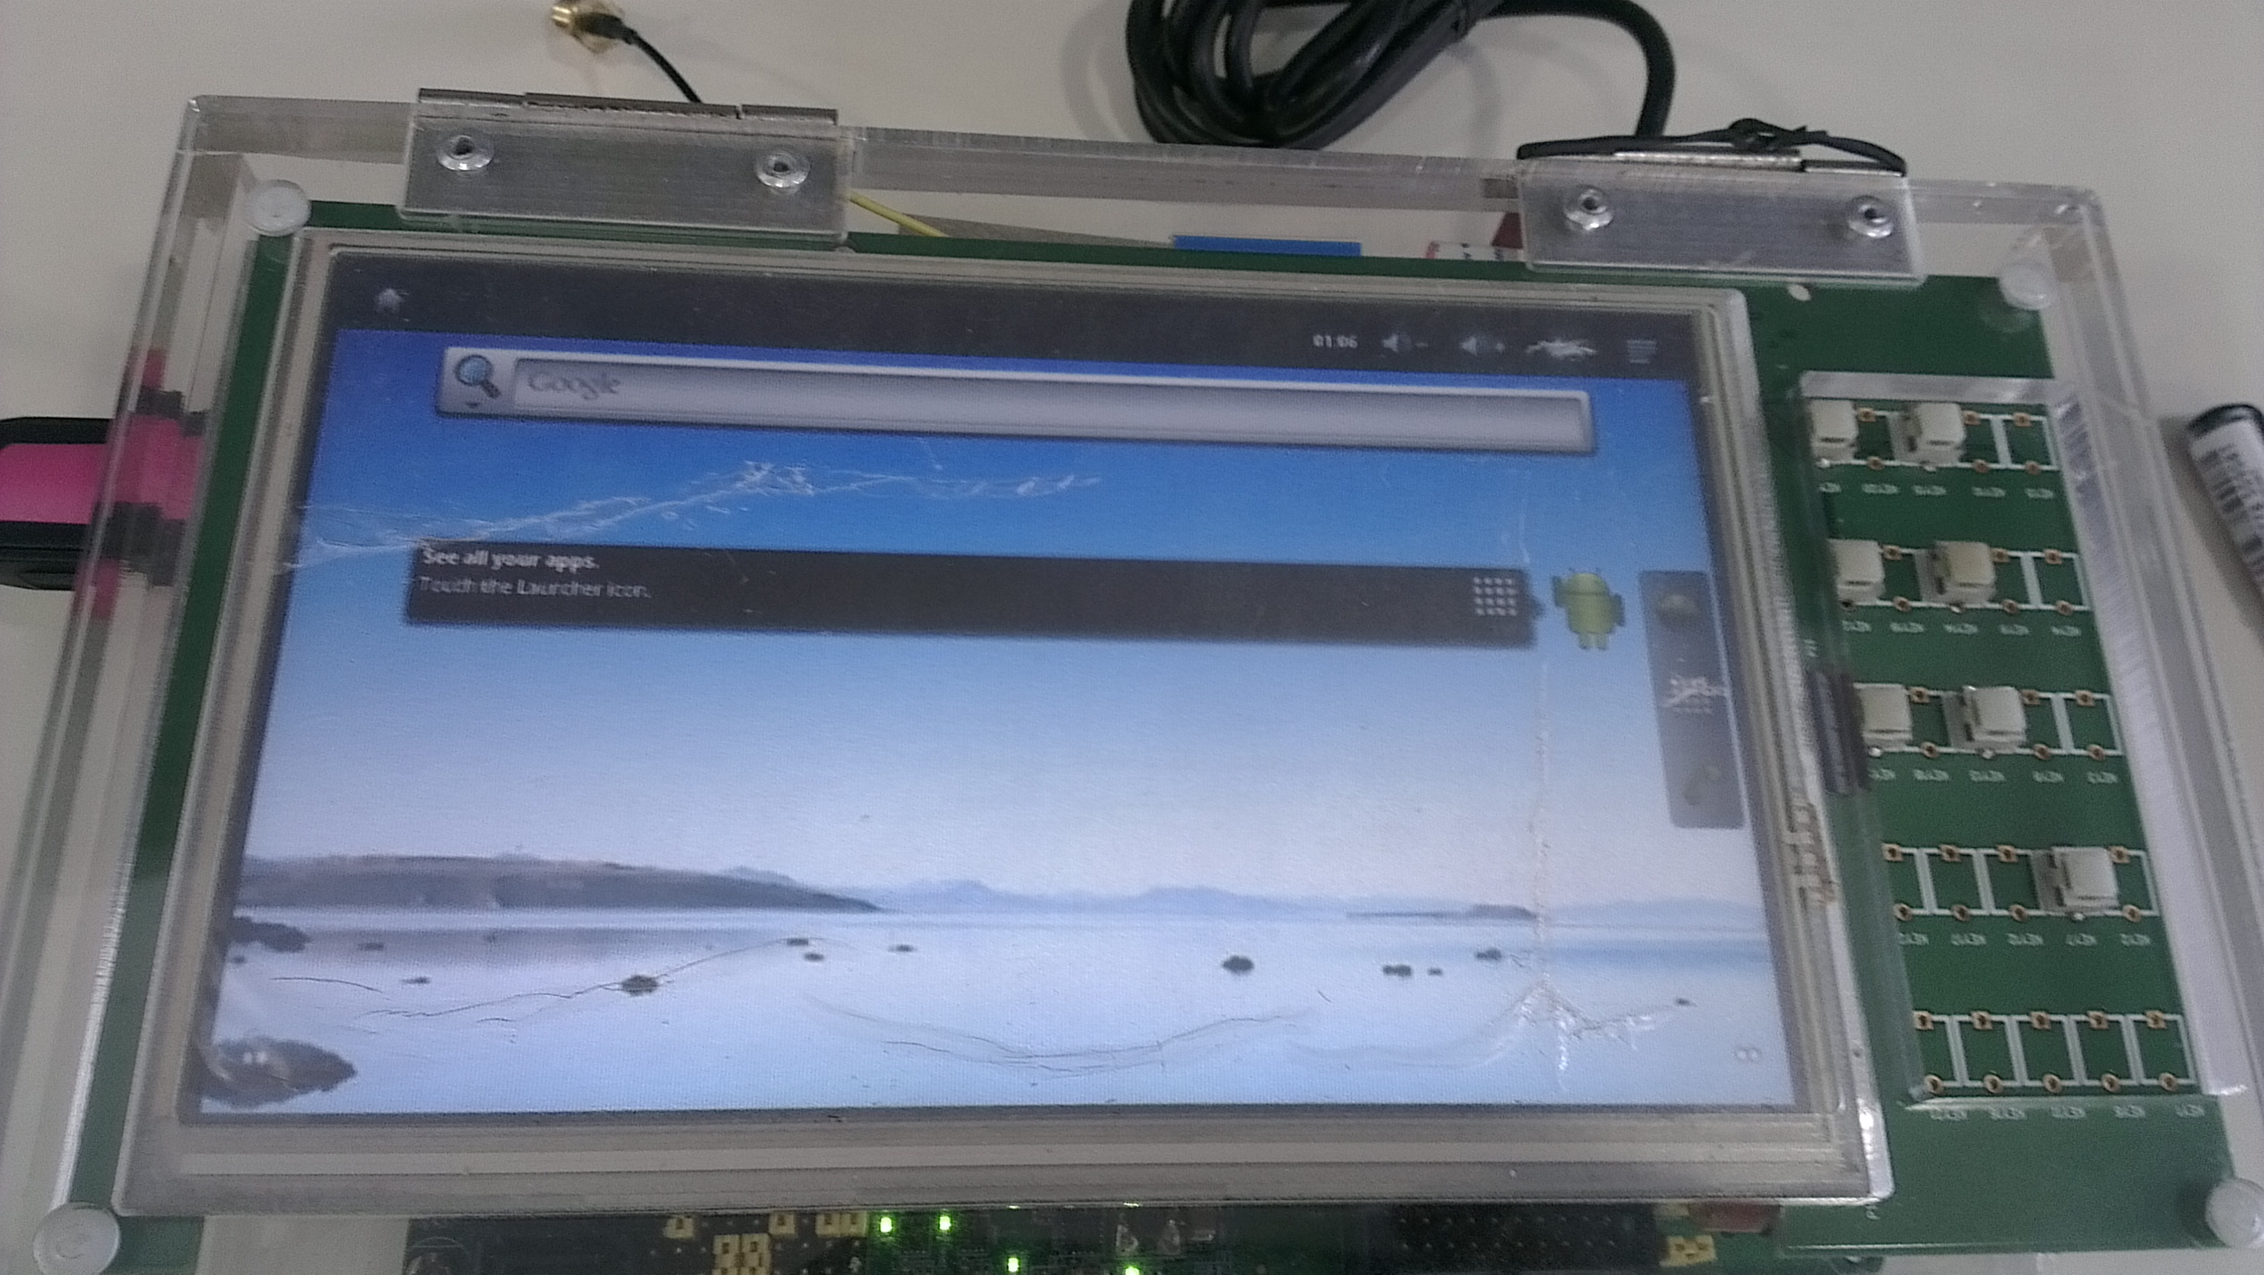
Bring up board
Home screen

